Slide 1

DSC-530 Final Project
In this project, we will answer the question of” What makes a movie popular?”. We hear many explanations from different people. Some associate the success of the movie with the actor or actress, and others claim that the reason is the large budget. Of course, there are many and varied claims, but all of them do not exceed to be personal opinions. It can be false or true. It is not issued by experts and not the result of studies.
To deal with the weaknesses of those anecdotes, we will perform an exploratory data analysis to look for patterns and features that address the statistical question we defined above.
Prepared by Achraf Safsasfi

Slide 2
Preparing the dataset
So, to conduct the project, we will use a dataset, available in Kaggle, https://www.kaggle.com/danielgrijalvas/movies, of 6820 movies and 15 features, released from 1986 to 2016. Below is a description of the variables:
budget: the budget of a movie. Some movies don't have this, so it appears as 0
company: the production company
country: country of origin
director: the director
genre: main genre of the movie.
gross: revenue of the movie
name: name of the movie
rating: rating of the movie (R, PG, etc.)
released: release date (YYYY-MM-DD)
runtime: duration of the movie
score: IMDb user rating
votes: number of user votes
star: main actor/actress
writer: writer of the movie
year: year of release

Slide 3
But the data I want to keep for my project are

Slide 4
Understanding the structure of the data

Slide 6
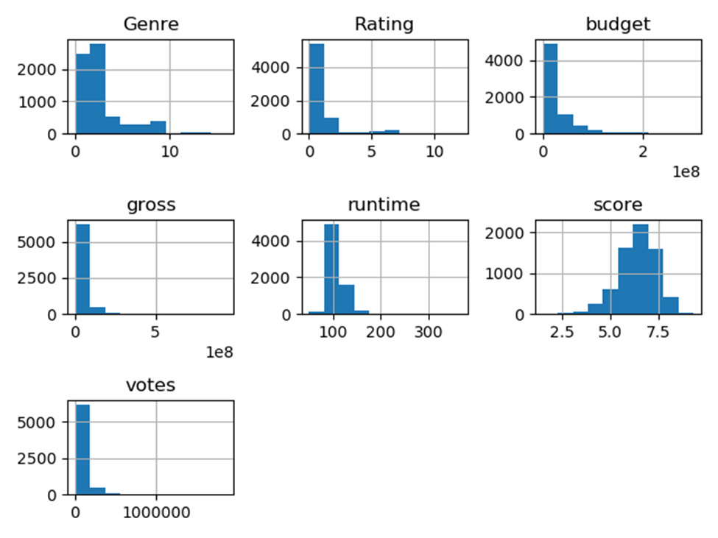
visualizing data

Slide 7
Detecting and removing outliers

Slide 8
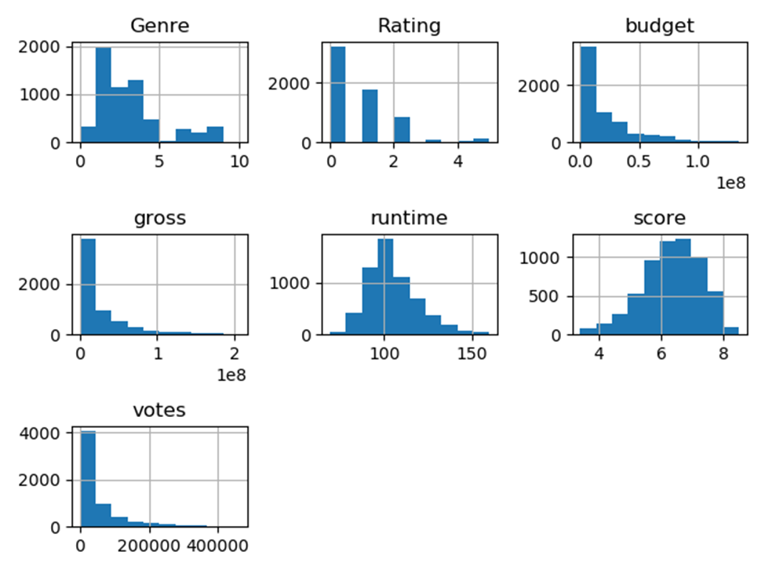

Slide 9
Describing the data

Slide 10
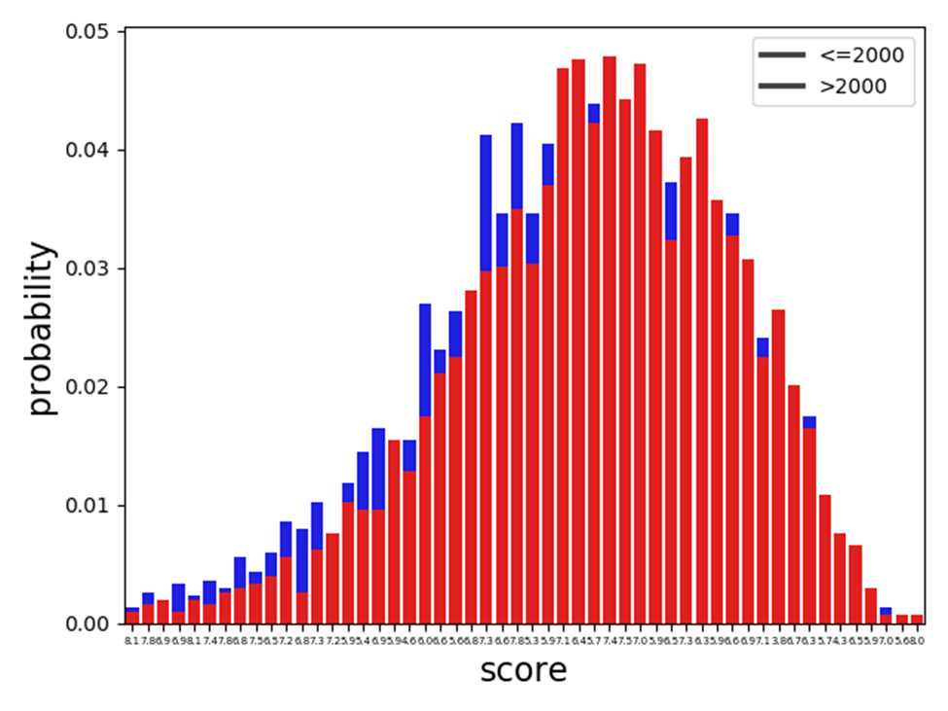
Plotting PMF
Before the year 2000, bad scoring frequented more than the good scoring, However, after the year 2000, movies had good scoring comparing to ones before the year 2000.

Slide 11
Correlation

Slide 12
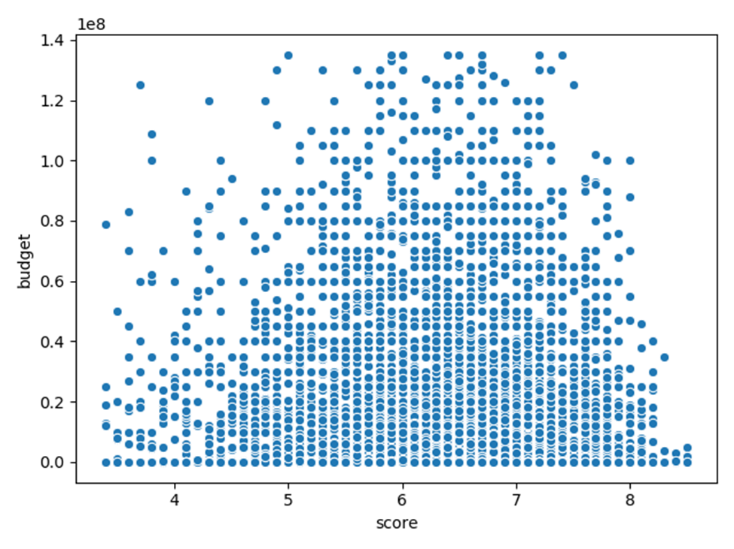
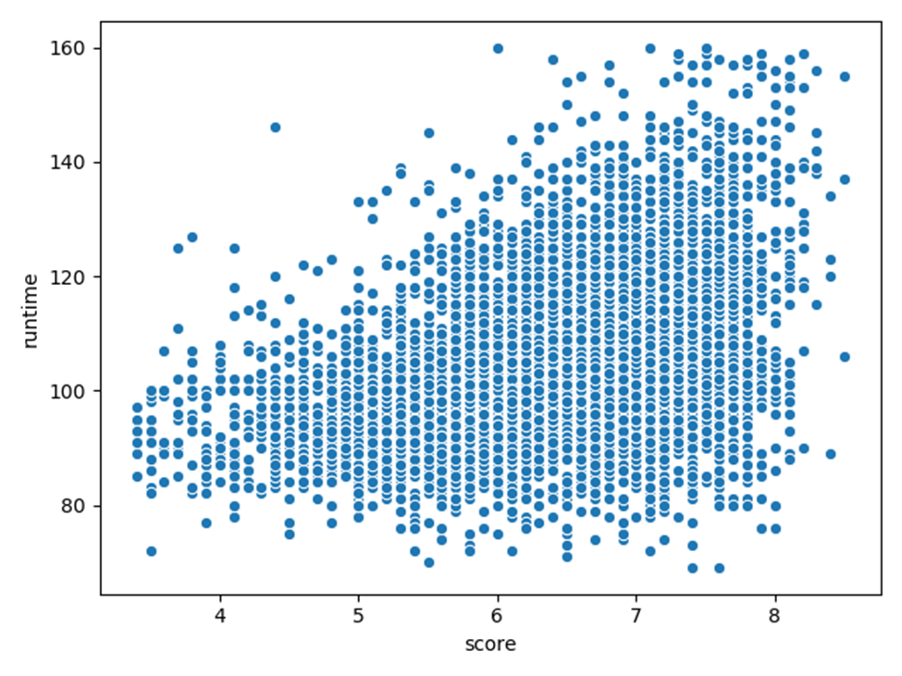
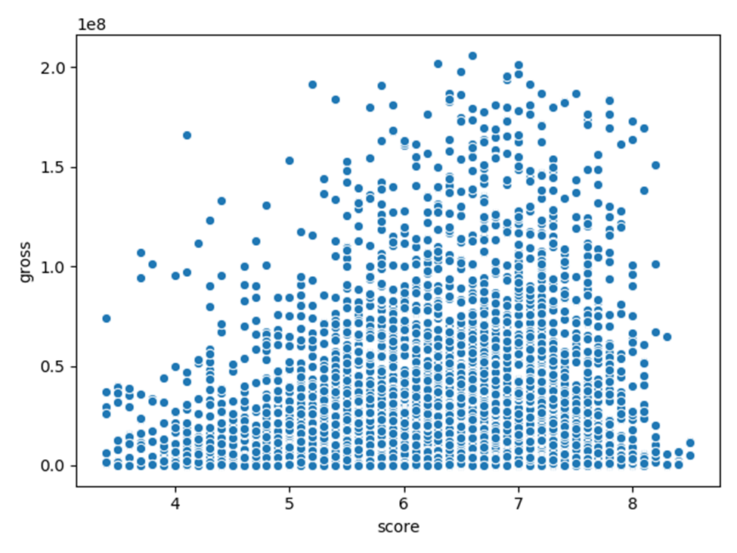
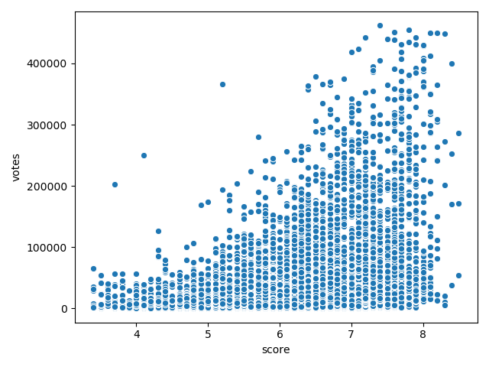

Slide 13
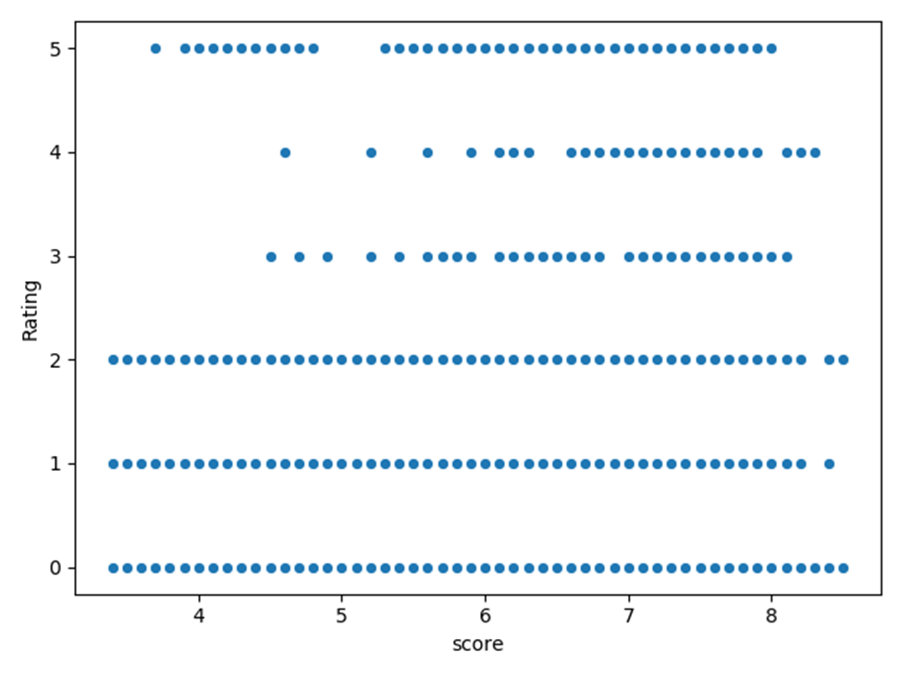
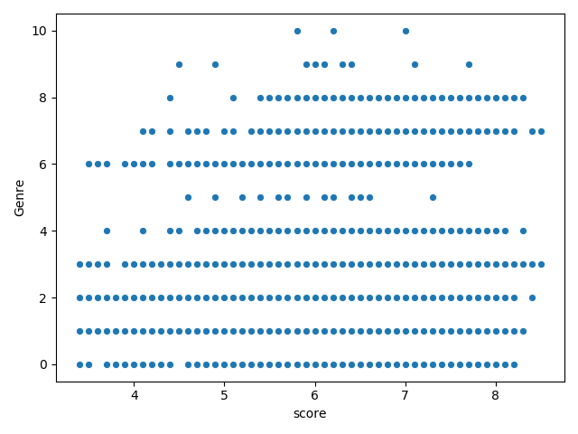

Slide 14
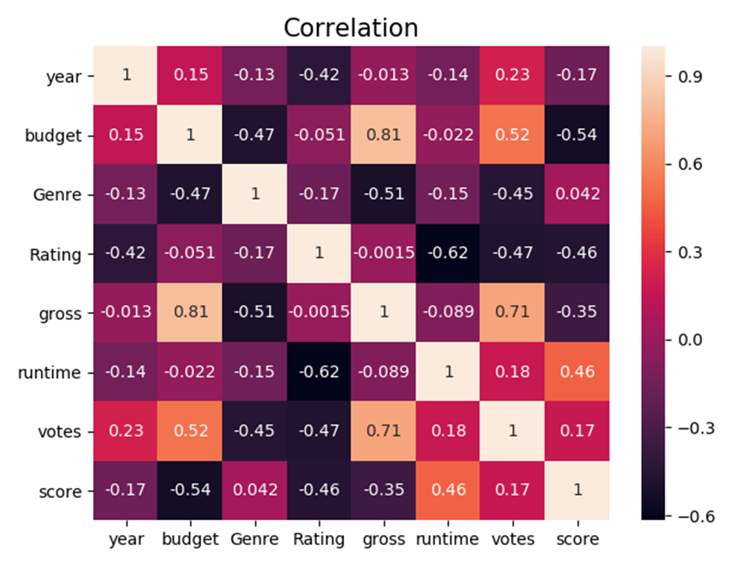
According to the plots and heatmap above, we can conclude that
the linear relationship between score and budget is moderate negative (r= -0.54) and the budget variable explains about 29% of the score variable (r^2 = 0.29).
the linear relationship between score and genre is negligible (r= 0.042) and the genre variable explains about 0.18 % of the score variable (r^2 = 0.00176).
the linear relationship between score and rating is low negative (r= -0.46) and the rating variable explains about 21% of the score variable (r^2 = 0.21).
the linear relationship between score and gross is low negative (r= -0.35 ) and the gross variable explains about 12% of the score variable (r^2 = 0.12).
the linear relationship between score and runtime is low positive (r= 0.46) and the runtime variable explains about 21% of the score variable (r^2 = 0.21).
the linear relationship between score and votes is negligible (r= -0.54) and the votes variable explains about 2.9% of the score variable (r^2 = 0.0289).

Slide 15
Pearson's Correlation test

Slide 17
According to the outputs above, the correlation between score and other variables is unlikely to have occurred by chance.

Slide 18
Building a binary logistic regression model
Next, I will build a binary logistic regression to predict whether a movie will be popular or not. For me, I consider a movie is popular if it is scored well. So I will set the score variable as the target variable of the model. To do this, I will encode the score variable as one of these two numbers, 0 or 1. The number 0 means an unpopular movie, and the number 1 means a popular movie. Since the average score is 6.3, I will consider any movie with a score higher than 6.3 a popular movie, and any movie with a score of less than 6.4 unpopular movies.

Slide 19
According to the coefficients above, the predictors' budget, gross, and votes have a small effect in predicting the movie's popularity. However, the variables' Genre, Rating, and runtime are considered good predictors in determining movie popularity.

